Slide 1
My name is Namita Bhatt. I am a Marketing professional from Telecom Industry & now a Design enthusiast with great interest in Startups.
I have an MBA with specialisation in Marketing and Bachelors in Zoology from Delhi University, India. Earlier as Marketing Manager, I worked with Maxis Telekom responsible for Multi-city launch across India for both mobile product line. I also managed the advertising campaign across media. I am a detail-oriented person with good skills in problem solving. I believe my good commmunication and collaboration skills have helped me work with diverse teams & get projects done with faster time to market. I have also worked in Market Research covering multi-industry with focus on software services in European Market. Last year I worked with HR SaaS platform startup helping them expand their operations in Europe.
As part of UX design I designed Vela- Weather App for water-sport enthusiasts. As a designer my aim is to create an intuitive user interface with all the desired functionality. My focus is on extensive market research and competitor analysis to help me understand the missing link between the user need’s and what the market is offering right now.
Tools
Adobe XD
Sketch
Powerpoint
Word
Skills
Market Research
User Persona Creation
Information Architecture
Wireframing and Prototyping

Slide 2
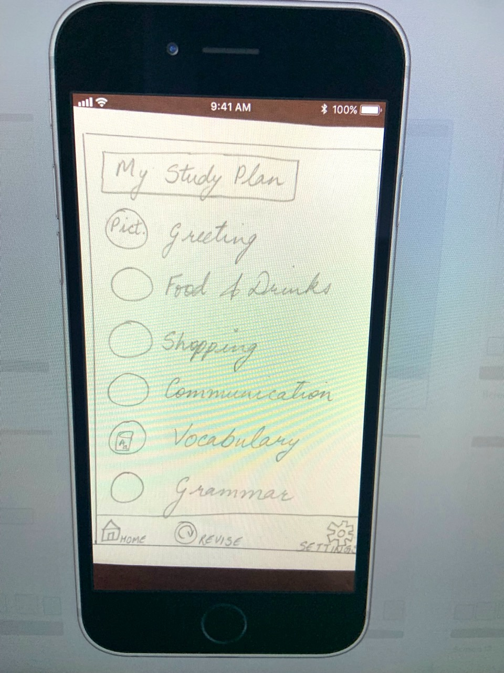
“Vela” Personalised Weather App
“Lets Do It” Language App

Slide 3
Presenting Project ”Vela”- Weather App for water-sport enthusiast
While researching I realised most of the free weather app in the market gives a lot of general weather information. I wanted to make the weather app where you get detailed weather information customized for users, so its easy to read even when you are on a move. It took me almost 9 month to reach the solution.
User Journey
Framework for the App
Started with market research and competitor analysis help me in understanding the market and my users need better. This information became the foundation for creating User Persona and their User Journey.

Slide 4
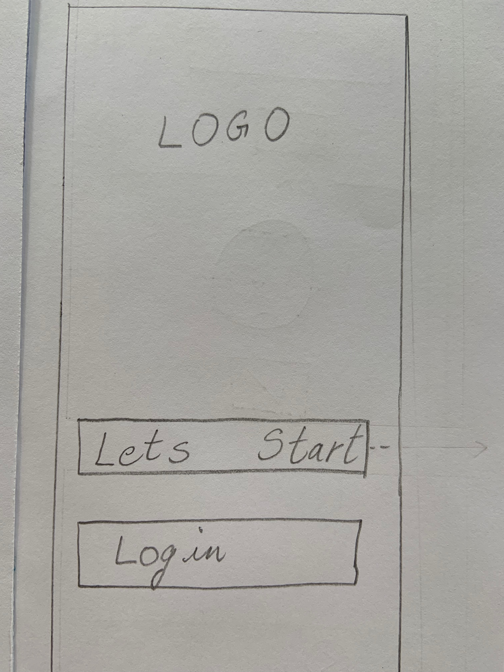
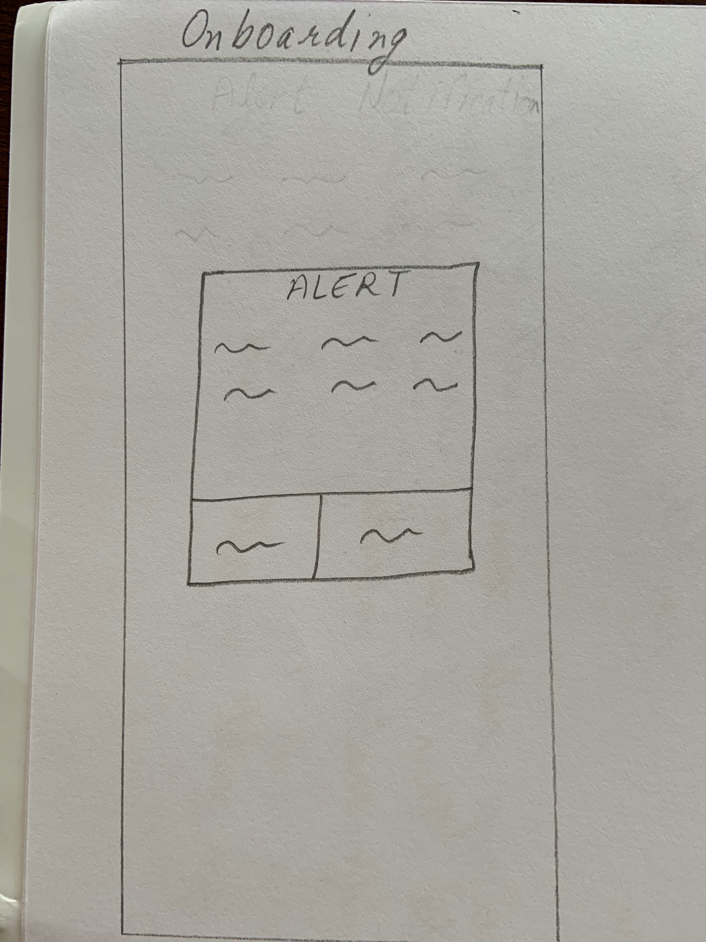
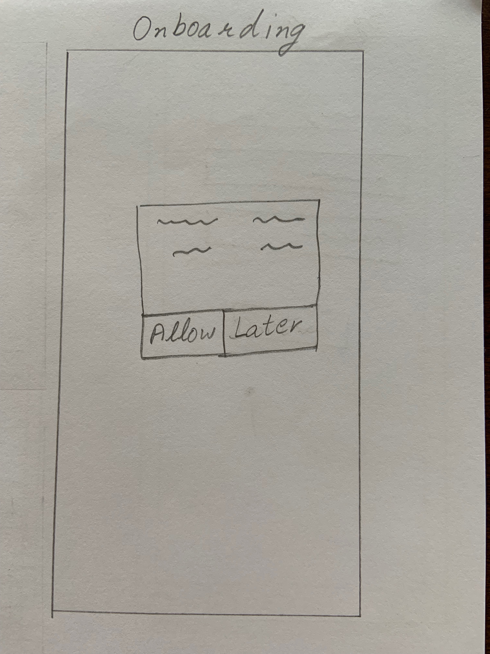
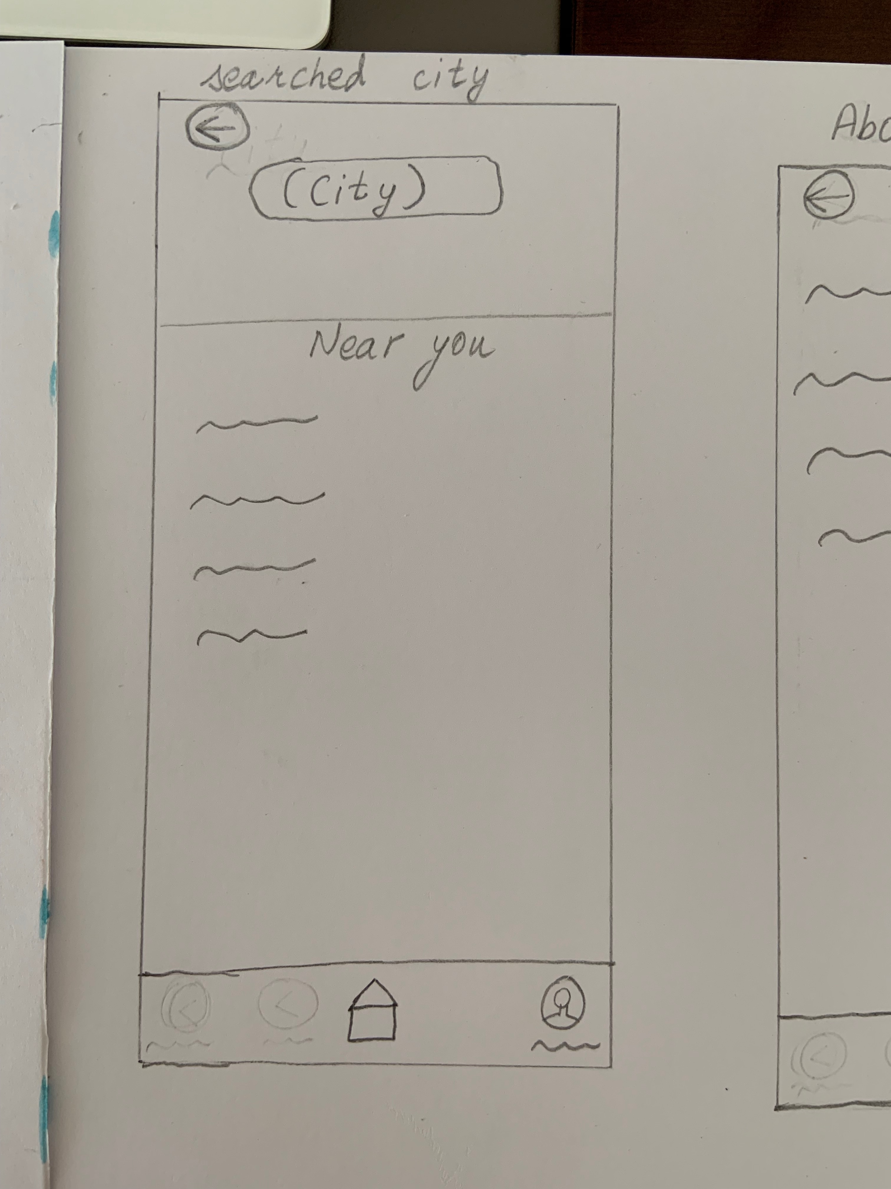
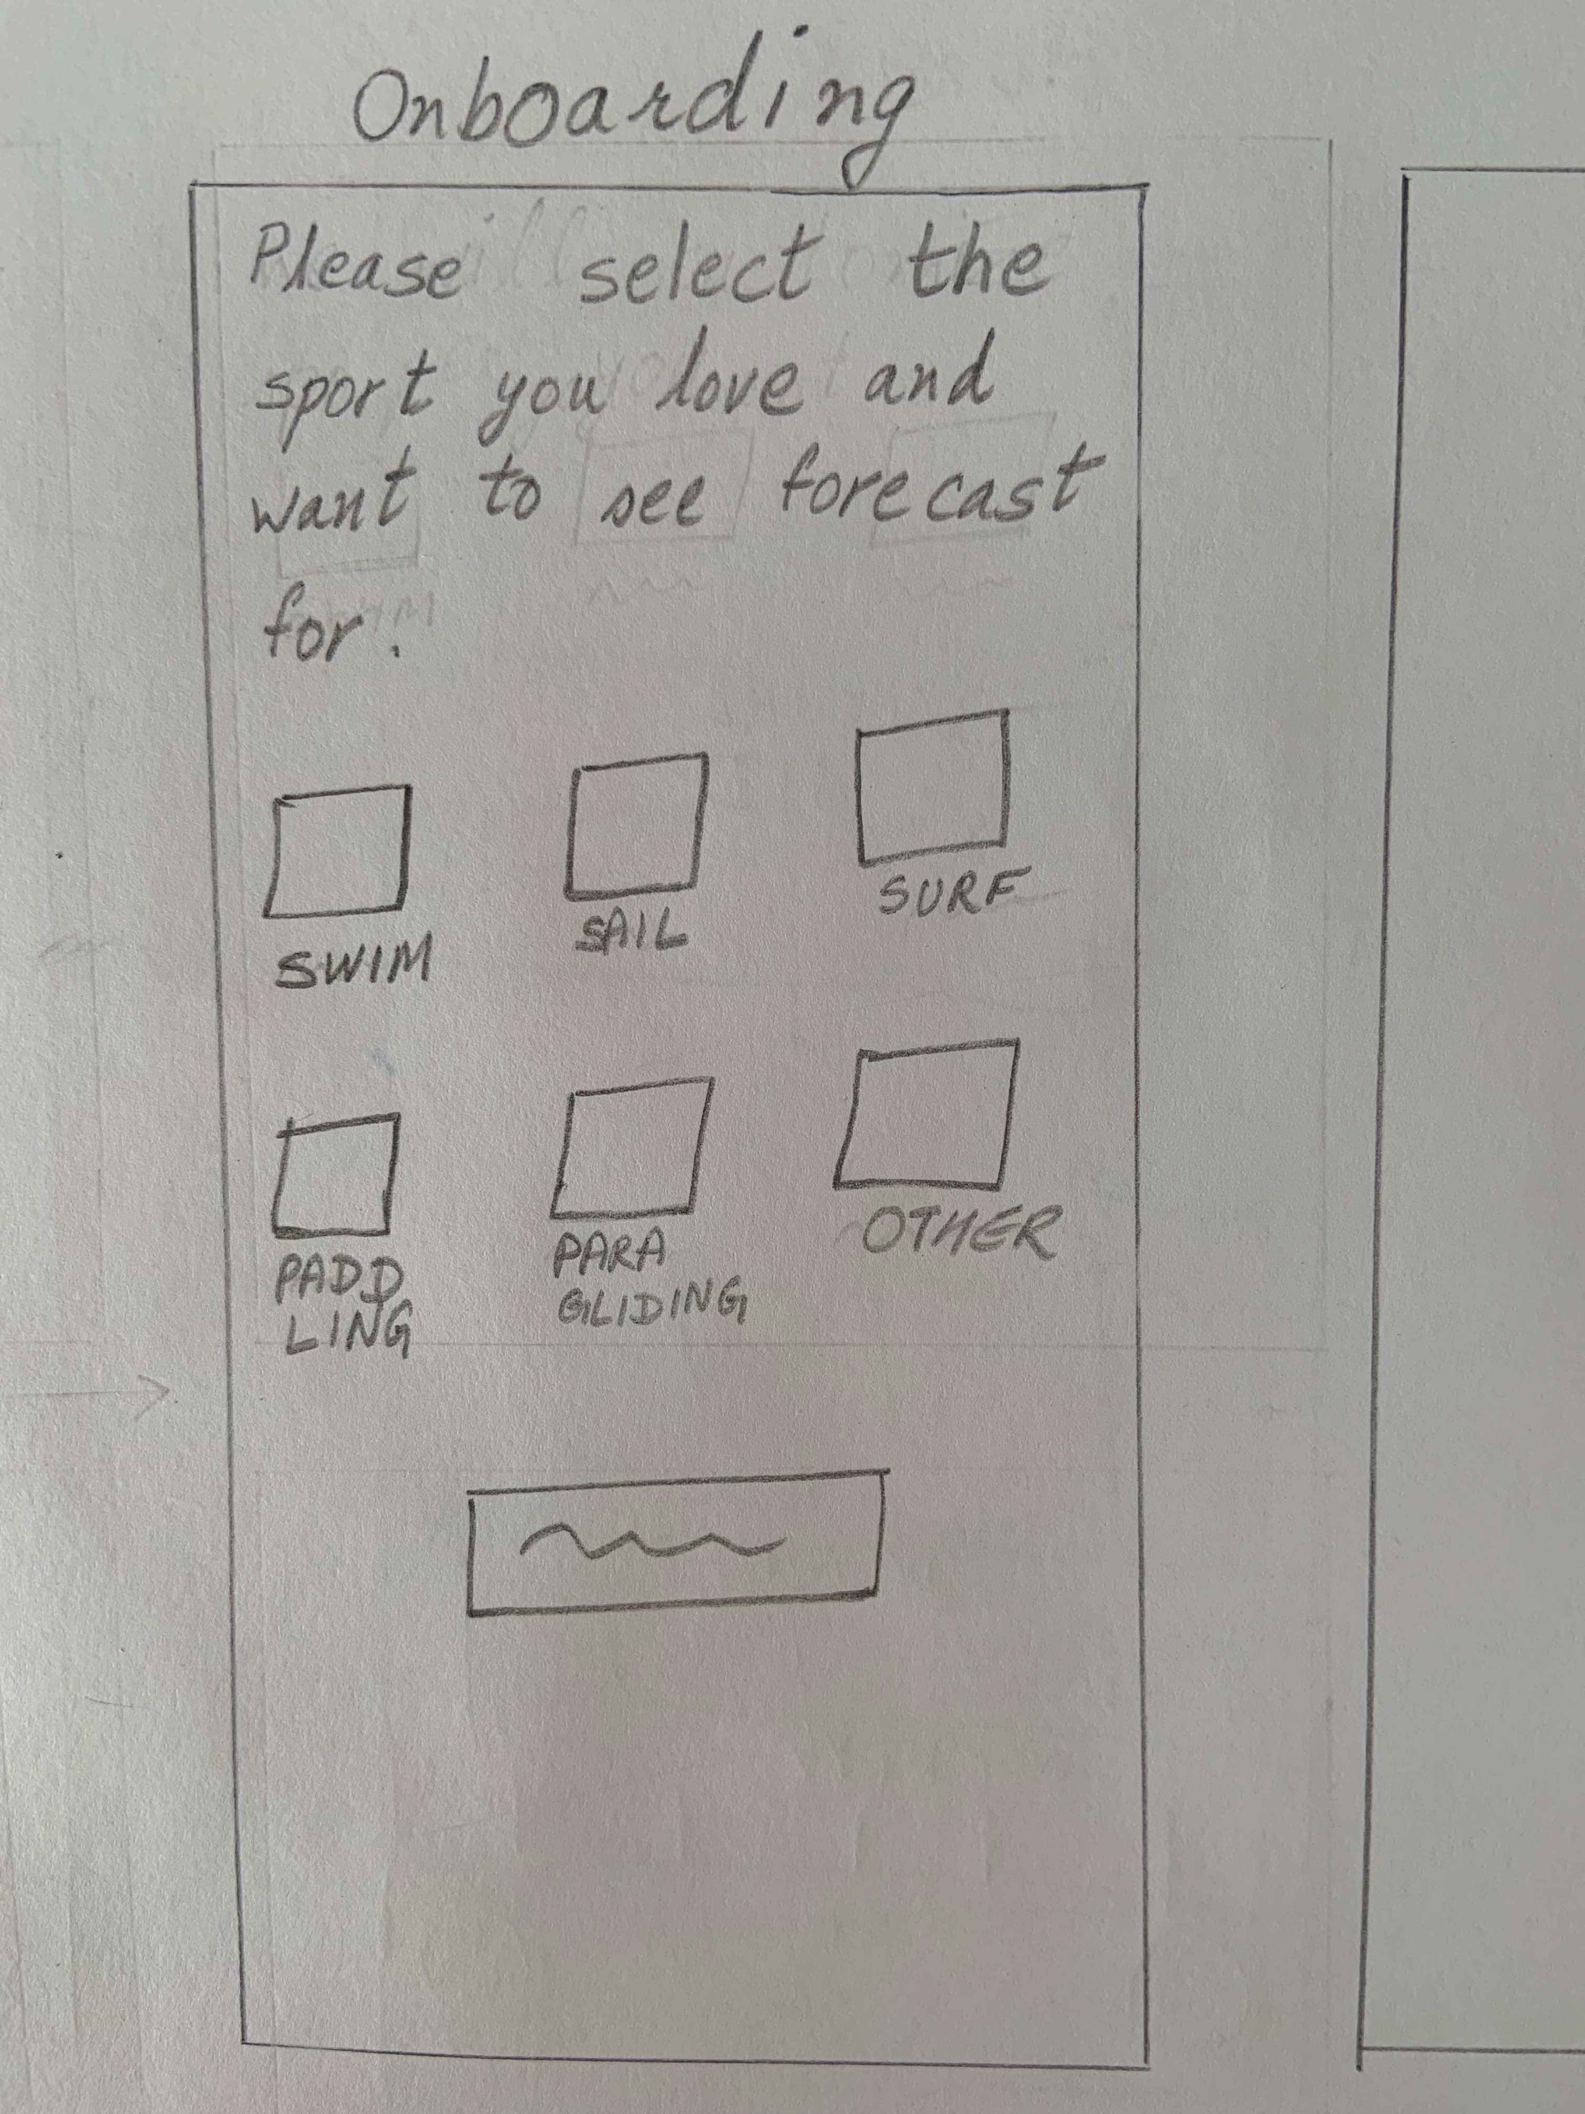
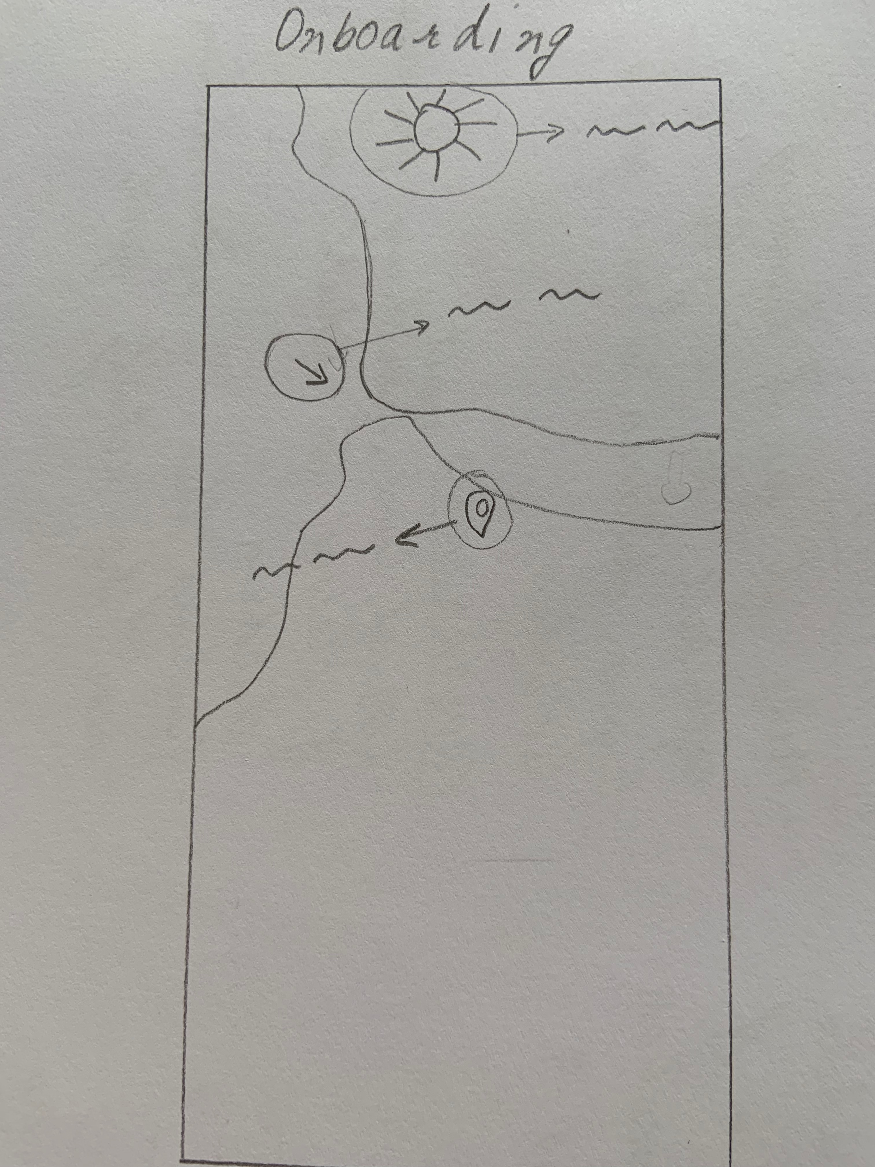
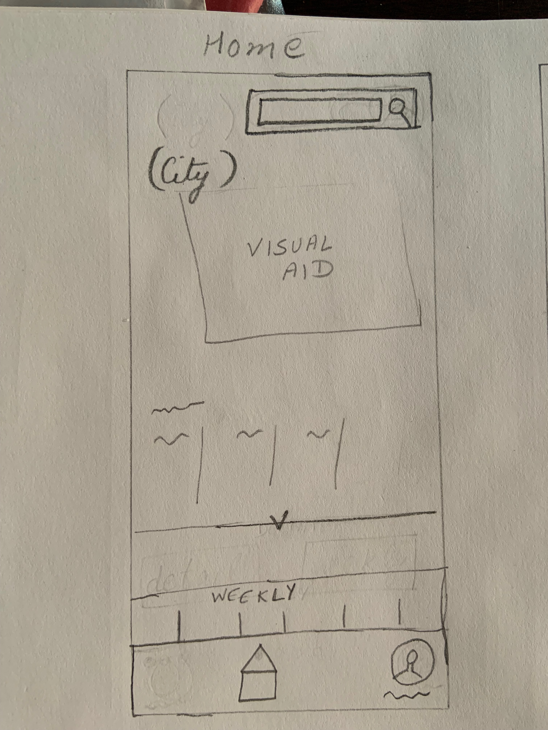
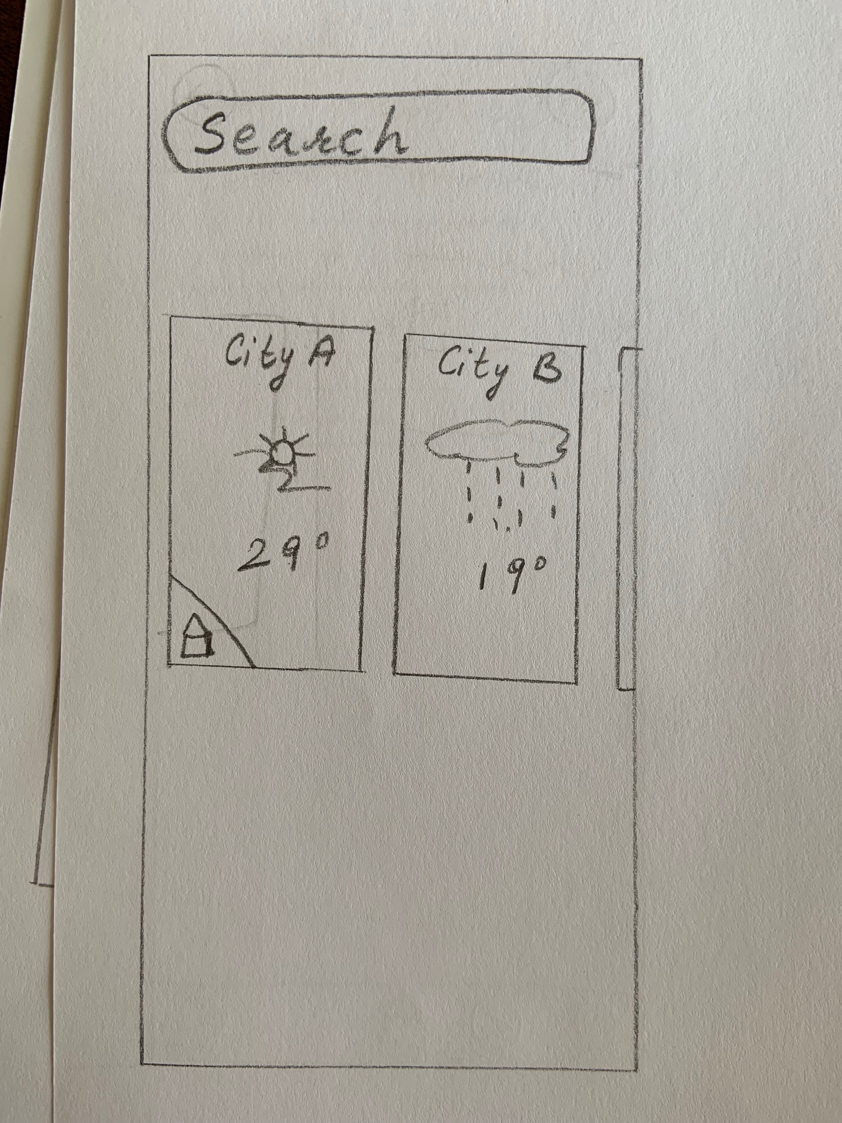
Based on the Information Architecture, I started sketching the low-fidelity wireframes. Below are the screenshots of some of them.

Slide 5
The sketches were the base for my Wireframes on Adobe XD. The design was then tested in-person with different users to identify the problem areas. Accordingly the design were iterated and redesigned. I used the revised designs for Prototyping ( link https://xd.adobe.com/view/a6dc5bf3-e0e7-4e2a-4f7f-8b7712644d80-d0ed/ )

Slide 6
Here are some of the examples how the design changed with each feedback and testing with users.
Incase you would like to check out my online Portfolio, please click here
https://www.behance.net/gallery/91137435/Vela-My-UX-Project

Slide 7
Once upon a time, there was a ...
Color Palette
Font Family:
Helvetica Neue
My learnings in the last 9 month were, how much market research of existing product/services as well as questioning the users and taking their feedback impacts the final offering.
What we while designing think is self explaining is completely lost on the users testing it.
All in all a good learning.

